Slide 1
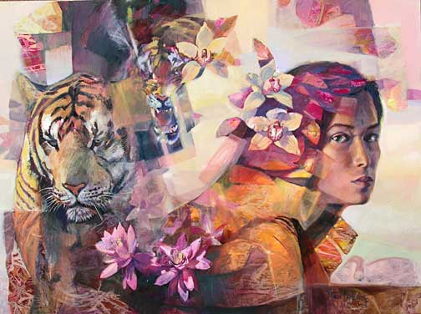
The Lady or the Tiger
By Frank R. Stockton

Slide 2
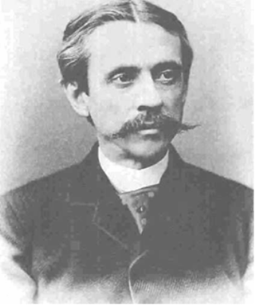
Frank R. Stockton is the author of the short story, “The Lady or the Tiger.”

Slide 3
Frank R. Stockton 1.
Noun
author of the story. Published in 1882. Mainly wrote stories for children . This is not a true story. It is a work of fiction

Slide 4
Irony
Identify types of irony by giving examples from “The Most Dangerous Game,”
Be able to identify and record examples from the Story, The Lady or the Tiger after reading.

Slide 5
Irony
“Isn’t it ironic? Don’t you think? It’s like a free ride when you already paid” (Alanis Moresett).

Slide 6
Irony 3.
A contrast or an incongruity (clash) between what is stated and what is meant (verbal), or between what is expected to happen and what actually does happen (situational).

Slide 7
Example
It’s ironic that Rainsford (a well known hunter) swims to an island to get hunted. It’s not what you’d expect. More specifically it’s situational irony.

Slide 8
Verbal Irony 6. And 7.
A writer, speaker, or narrator says one thing and means something entirely different.

Slide 9
Example
The title of the story, “The Most Dangerous Game” which we expect a game to be fun, but this game is not fun.

Slide 10
Situational Irony 9 &10
A contrast between what is expected and what actually happens.

Slide 11
Examples
Rainsford is an expert hunter who happens to swim a shore to be General Zaroff’s most challenging hunt yet.
The fact that he happens to be an expert hunter.

Slide 12
Dramatic Irony 12 and 13
The reader or audience perceives something that a character in the story or play does not know.

Slide 13
Dramatic Irony
We know that Rainsford is hiding behind the curtain, but General Zaroff does not know.

Slide 14
Breaking the Fourth Wall 15.
The author directly addresses the audience.
The author does this when he leaves it up to the reader to decide.

Slide 15
Examples
Malcolm in the Middle (TV. show) in the middle of the episode, he will speak directly to you, the audience.
Frank R. Stockton page 36 (bottom of first column)

Slide 16
Characterization 19.
The methods an author uses to develop a character.
Direct: directly states the traits
Indirect: when the author shows the traits

Slide 17
Foreshadowing 20.
Clues that the author gives throughout the story to help develop the plot

Slide 18
Conflict
A struggle between two opposing forces or points of view. There are two types (internal and external)

Slide 19
Internal
When a character struggles with a force within themselves.

Slide 20
Internal Conflict Example
The princess struggles with the decision to point to the direction of the door that contains a lady (the one lady that she is jealous of and hates the most), or she has to decide if she can stand watching her lover get attacked by a ferocious tiger.
The princess struggles to overcome her jealousy!

Slide 21
Internal Conflict Example
The young courtier (knowing the nature of the princess) has to decide whether or not to trust the princess.

Slide 22
External Conflict
A struggle between a character and an opposing outside force. (person vs. person, person vs. fate, person vs. nature, person vs. God/gods, person vs. society)

Slide 23
External Conflict
Man vs. man (courtier vs. semibarbaric king)
Man vs. fate (courtier vs. trial’s chance)
Man vs. Society (courtier vs. audience acceptance of this form of judicial system)
Man vs. Nature (courtier vs. tiger)
Woman vs. Woman (pricess vs. fairest lady)

Slide 24
Exposition
Beginning
Introduction
Establishes the setting, background information, possibly characters

Slide 25
Rising Action
Events that lead to the climax

Slide 26
Complications
Events/situations that add difficulty to solving/resolving the problem

Slide 27
Examples of Complications
The doors look identical, can’t hear, it’s different every time, it’s a 50/50 chance
The woman behind the door is the fairest lady in the land and the one woman the princess hates
The most ferocious tiger was chosen

Slide 28
Climax
The princess points discretely to the right door (she know what is behind each one)
The courtier opens the door

Slide 29
Falling Action
Events that lead to the resolution or ending

Slide 30
Falling Action
Something comes out of the door

Slide 31
Resolution
The ending
How the story ends...how the conflict/problems are resolved

Slide 32
Resolution
Missing
The author leaves it up to the reader! You decide if the courtier is devoured or married.

Slide 33
Resolution
Missing
The author leaves it up to the reader! You decide if the courtier is devoured or married.

